Slide 1
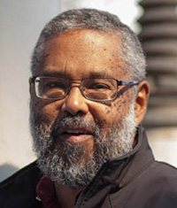
African-American UUs:
A History Far Richer Than You Think
The Reverend Dr. Mark Morrison-Reed
One of the first African-American UU ministers
Hear this distinguished scholar and minister discuss his memoirs of integration; black trailblazers and missed opportunities in Unitarian Universalism; how the Civil Rights Movement changed UUs; and the quest for spiritual integration as the new frontier.
His riveting books are available through the Book Nook or http://www.uuabookstore.org/. Time for book signing will be made during the program.
Please join us:
Friday, May 2
Chapel
Potluck Dinner: 6:30 pm
Program: 7:30 pm

